Slide 1
AirKitchen:
Week 9 Update
Team FoodXYZ
Mengdan Yuan, Wen Xin

Slide 2
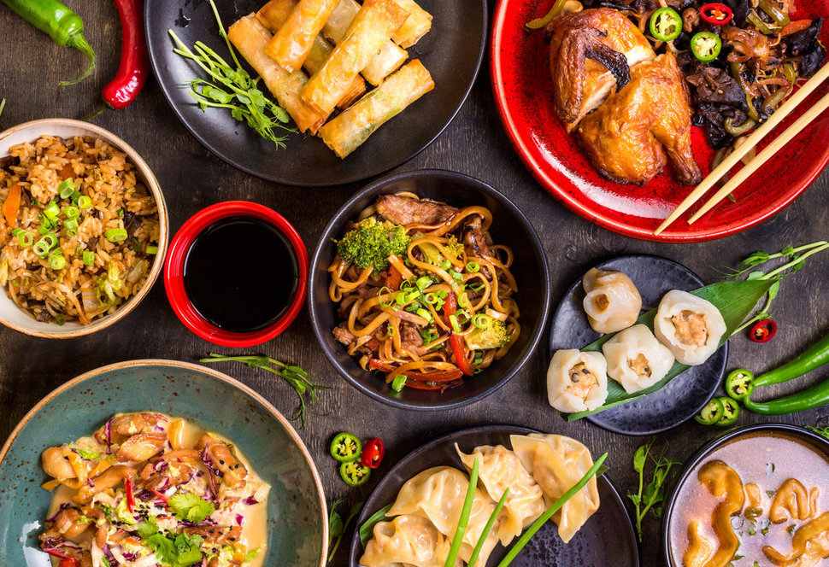
https://img.huffingtonpost.com/asset/585be1aa1600002400bdf2a6.jpeg?ops=scalefit_970_noupscale

Slide 3
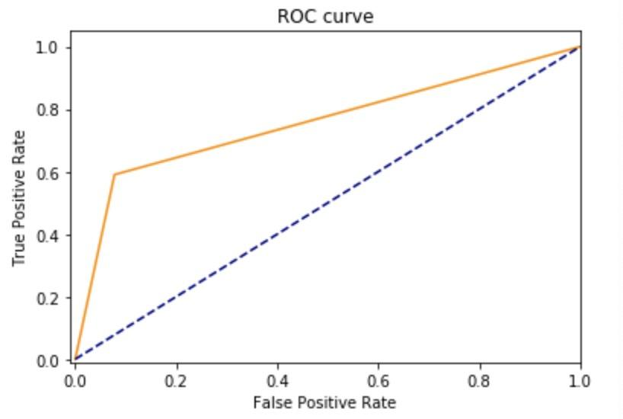
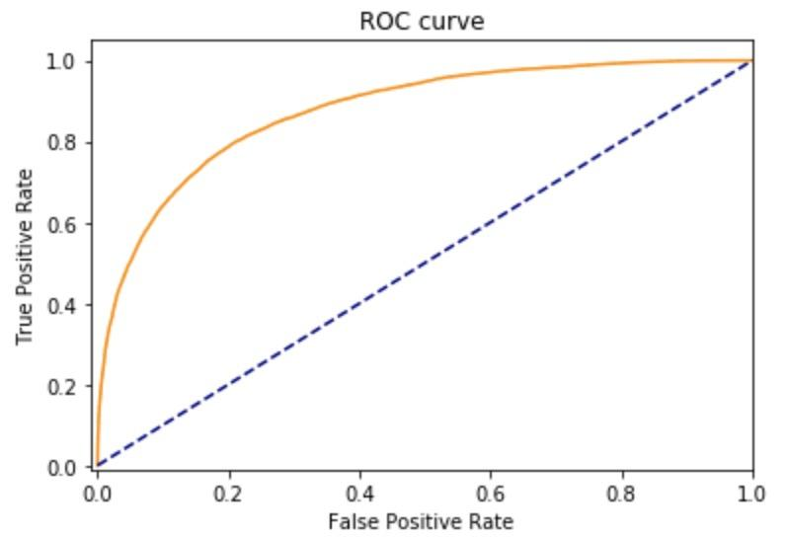
We made a huge mistake...
We calculated the ROC score using the predicted labels instead of probability,
So in fact our score is pretty well !
Before 0.75 After 0.87

Slide 4
What we tried to improve models:
Feature:
Delete daily features
Preprocessing:
Oversample (SMOT)
Remove outliers (any value outside mean +- 3 standardized deviation)
Model:
Linear models-> non linear models

Slide 5
Model & Insight
Good prediction whether users will retention or not, help market people to filter users to send coupons
Closer to 1, better imbalanced classification
Model | Training set ROC score | Test set ROC score
Logistic Regression | 0.8827 | 0.8742
Ridge Classification | 0.8851 | 0.8726
Light GBM | 0.9551 | 0.8768
Random Forest | 0.8917 | 0.8765

Slide 6
Challenge
Hard to improve Classification Models: performances of four models are good but similar
keep improving the performance of classification models and explore more complicated models
switch to regression

